Slide 1
Event Management System
Capstone project

Slide 2
Project Done By
Group 1
Chetan Salunkhe
Neha Kumari
Manikanta

Slide 3







Technologies Utilized
Spring Boot
Angular
Git/GitHub
Postman
Bootstrap
MySQL
VS code
AWS

Slide 4
Abstract
Event Management system manages all the event
This application supports organizer, user and admin registration and login, and user can book the event.
Organizer get the all access of user and its getting all history of user
which is event book
User and organizer details information are stored in a MySQL database
The database is accessed by SpringBoot and user requests are handled with Angular on the front end
Login Through Organizer - Create New Organizer Account, Manage Venue, Add New Venue, Add New Events, Add Food Items, Add Equipment, View Bookings, Upcoming Bookings, See Booking History, See All Notifications, See Our Profile.
- Login Through User - Create New User Account, Available Venues, Book Event, Do Payment, See Booking History, View Venues, Check Availability, See All Notifications, See Payment Status, See Events, See Food Items and See Equipment, See Our Profile.

Slide 5
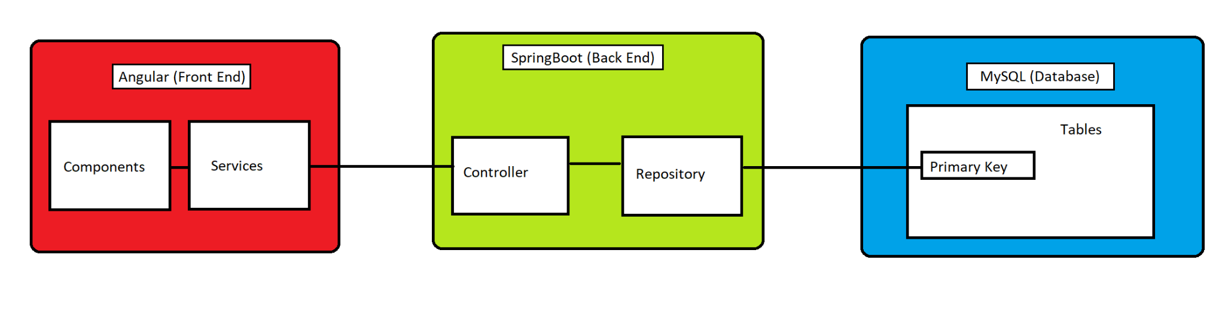
Architecture Diagram
S3 Bucket
EC2
RDS

Slide 6
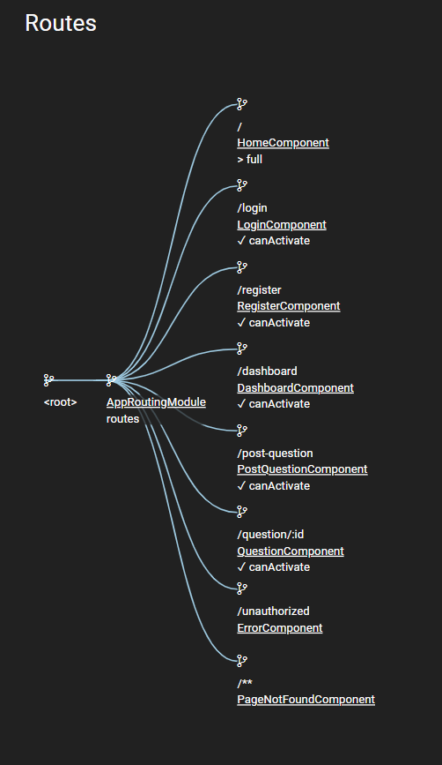
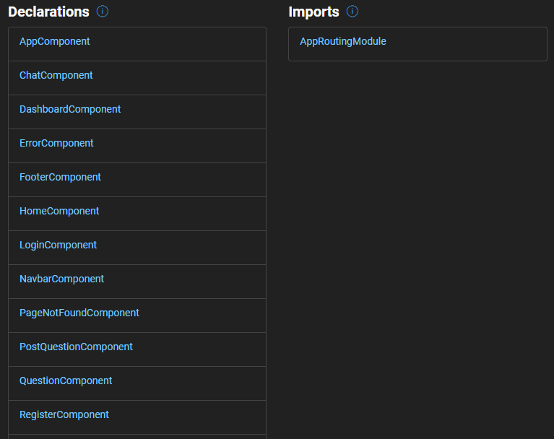
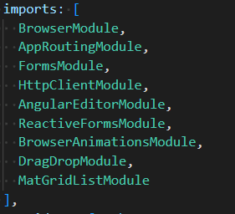
Angular routes, components and imports

Slide 7
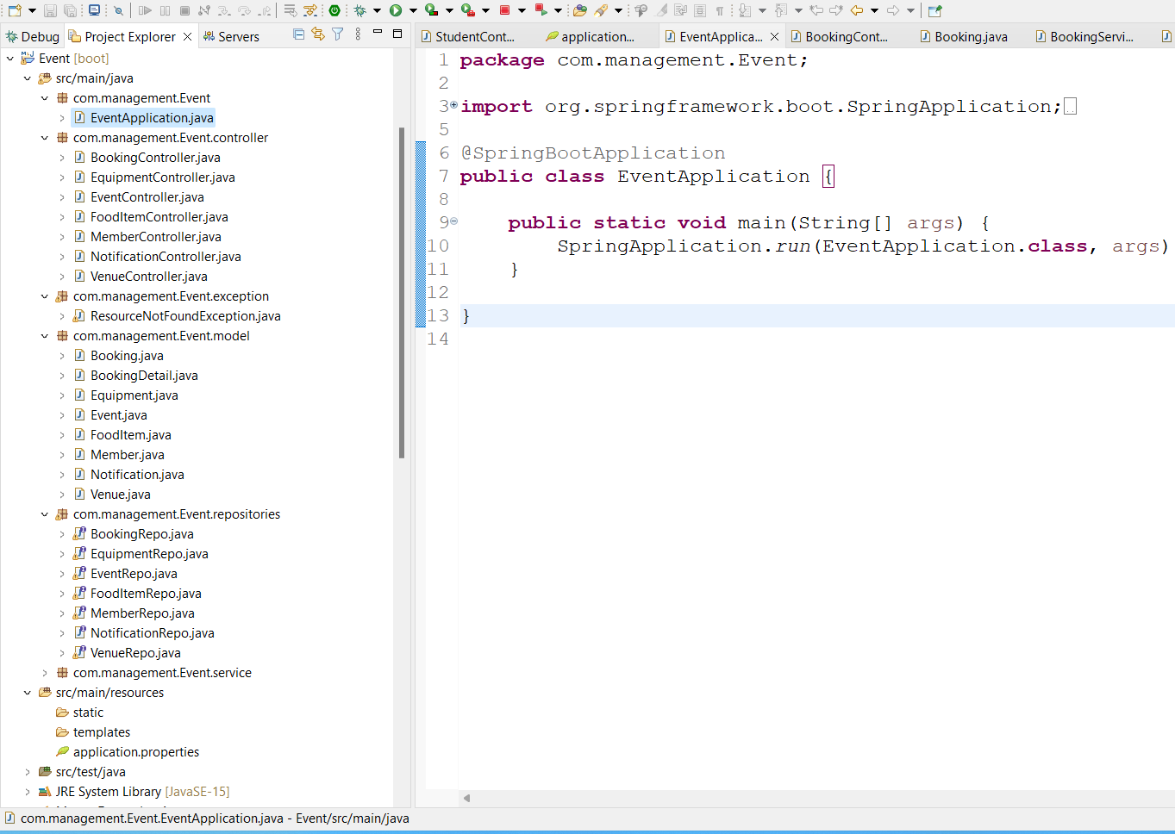
Java Backend Class Hierarchy

Slide 8
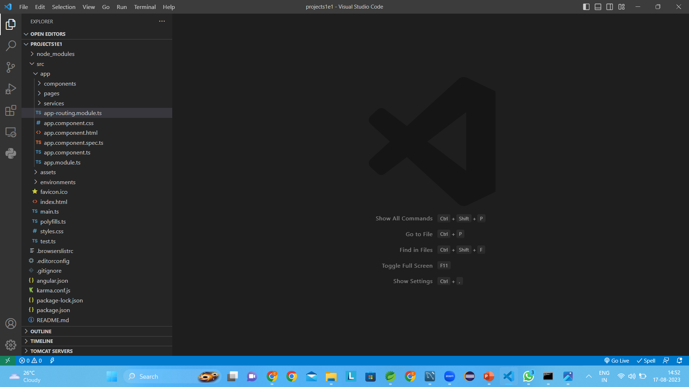
Angular Frontend Class Hierarchy

Slide 9
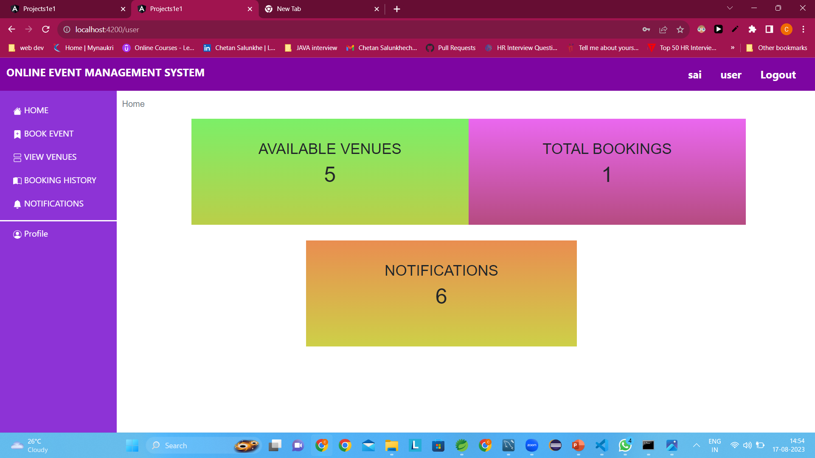
User page

Slide 10
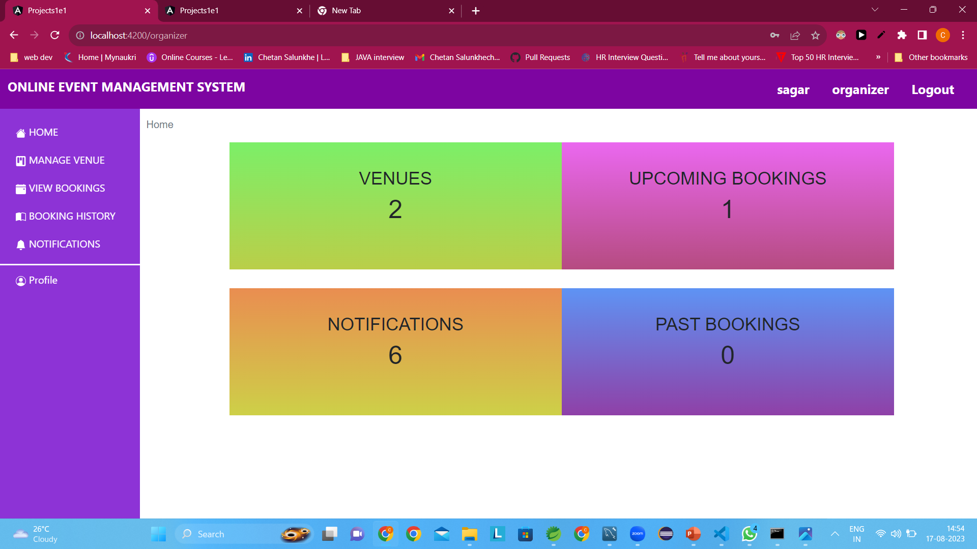
Organizer page

Slide 11
Conclusion
Event Management is the application of the project management of the creation and development of festivals, events and conference
Event management involves studying the intricacies of the brand, identifying the target audience , devising the event concept, planning the logistics and coordinating the technical aspects before actually launching the event.
Post-event analysis and ensuring a return on investment have become significant drivers for the event industry.

Slide 12

Thank you for listening !

